Slide 1
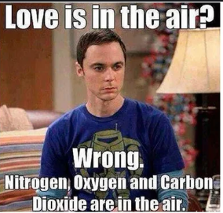
Before Sheldon and Penny moves to California, they were actually in NY. And in fact they met in Queens College one day.
Penny: Hey, Sheldon, What are you up to these days?
Sheldon: Not much. But I am taking a Data Analytics class. The professor looks normal, your know, his height falls kind of between the 45% to 50% percentile, slightly below the mean. But his lecture is funny. It is absolutely an outlier. His training was in Physics which I can say with 95% confidence that it should have no correlation with computer science, right? So, I wonder how he extrapolate his Physics knowledge to Computer Science.

Slide 2
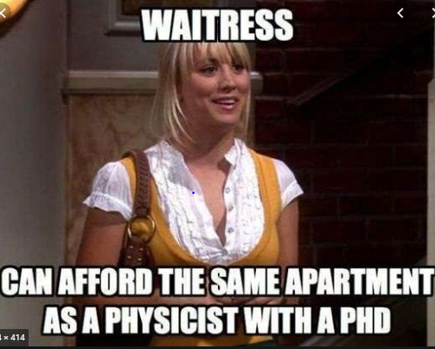
Sheldon vs Penny
Penny: Did you enjoy the birthday party yesterday?
Sheldon: There were too many weirdo and all sort of people around. The entropy is a bit too high for my liking. My alternative hypothesis is that the IQ distribution of the people in the party is highly negatively skewed. The kurtosis is obviously negative.
Hum… may be I can do a cross-validation, but if there are only 30 data points, the central limit theorem will not apply… I will need additional sampling ideas …

Slide 3
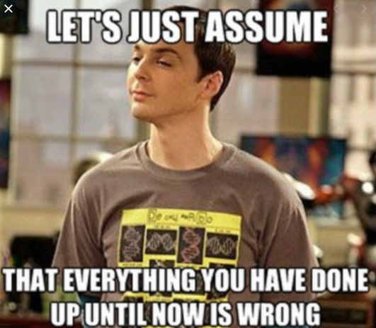
Penny: Shall we play golf today?
Sheldon: Well, we need to check if it will rain first, then to see if it will be windy, …, in fact I am now moving into a high dimensional space and visualizing a hyperplane to see if I can come up with the optimal decision boundary… oh .. oh… I see my support vectors now. The F1-score is about 90%.. OK. Yes, sure we can go now…

Slide 4



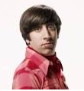


On Bias and Variance Trade-off of designing airplane flying from DC to NY
Low
High
Underfit
Overfit
Modeler | Design | Bias (low/high) | Variance (low/high) | Risk (over or underfit)
 |  | High | low | under fit
 |  | Low | High | overfit
 |  | Low | Low | Good fi
https://www.youtube.com/watch?v=EuBBz3bI-aA&feature=youtu.be

